Slide 1
Lecture 1 Introduction to Data Visualization

Slide 2
About the course
Course structure
7 lectures (presentations), pre-recoded
7 practical sessions, campus. See timetable! Groups A and B at different time
6 labs, work in groups 2 persons, campus
3 obligatory seminars, Zoom
Star-marked assignments in 3 occasions – to be solved individually, optional.
Examination
Submission of lab reports
Presentation of lab reports and opposition
Computer-based written exam
2 out of 3 star-marked assignments passed+ earned at least 14 points at the exam =get 2 points more

Slide 3
About the course
Information & Lab reporting
LISAM is used
Good lab practices
Supervision time is limited (2h)
Lab is normally put to LISAM a day before the lab supervision session
Start doing lab before the supervision session
Possible strategy: one individual in the group works with assignment 1, one with assignment 2 during the supervision time, then help each other later
To see who is your group member, check LISAM, Course Documents
Deadlines
Seminars are obligatory – speakers and opponents selected randomly

Slide 4
About the course
Course literature:
“Interactive Data Visualization” by M.O. Ward et al., Second Edition.
“Interactive web-based data visualization with R, plotly, and shiny “ by C. Sievert https://plotly-r.com/
Papers, software documentation & manuals

Slide 5
Introduction
Visualization in Statistics and Machine Learning…
… is a methodology that allows for discovering or confirming a useful information about the data by constructing and examining the graphical output
Course contents
Topic 1: Introduction to Data Visualization. Introduction to Ggplot2, Plotly, Shiny.
Topic 2: Perception and Visualization. Data preprocessing.
Topic 3: Basic graphs. Geospatial visualization.
Topic 4: Multivariate data visualization.
Topic 5: Interactive visualization. Text visualization.
Topic 6: Graph visualization. Animation.

Slide 6
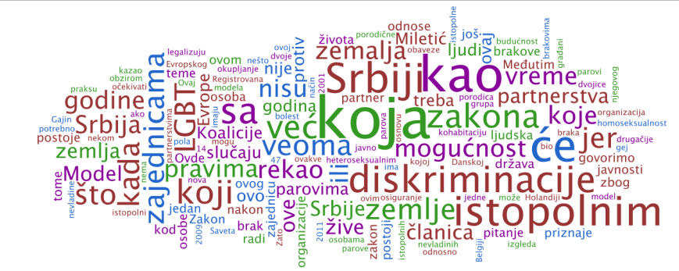
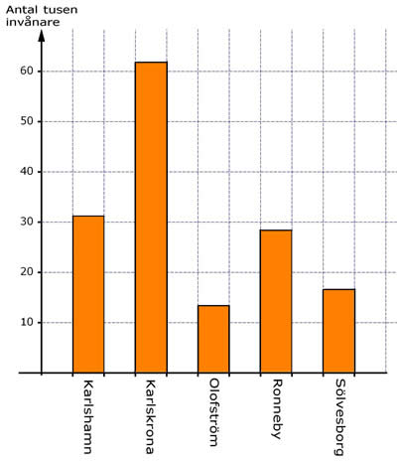
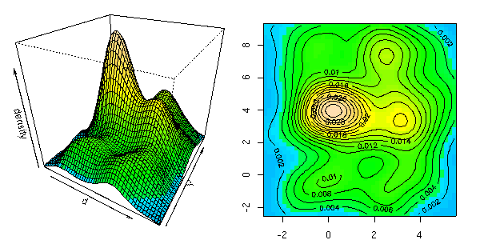
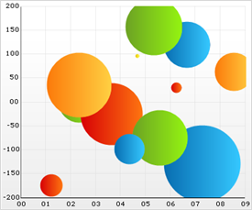
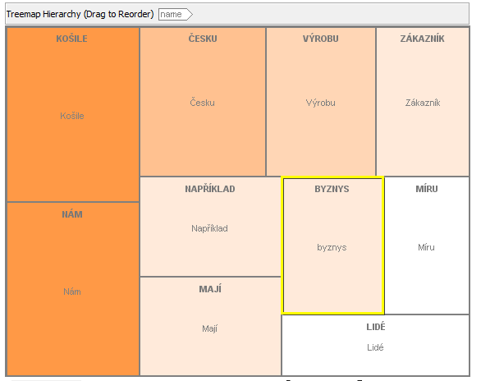
Viualizations

Slide 7
Different types of visualization
In this course, we focus on visualization=information visualization
Data→Visualization→Analysis
Related concepts
Computer graphics: Data are not necessary present, analysis is not normally assumed
Example: Computer games
Scientific visualization: similar to information visualization, often engineering data, statistical/machine learning analysis is normally not assumed
Example: Industrial robots

Slide 8
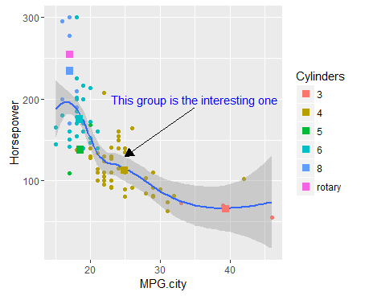
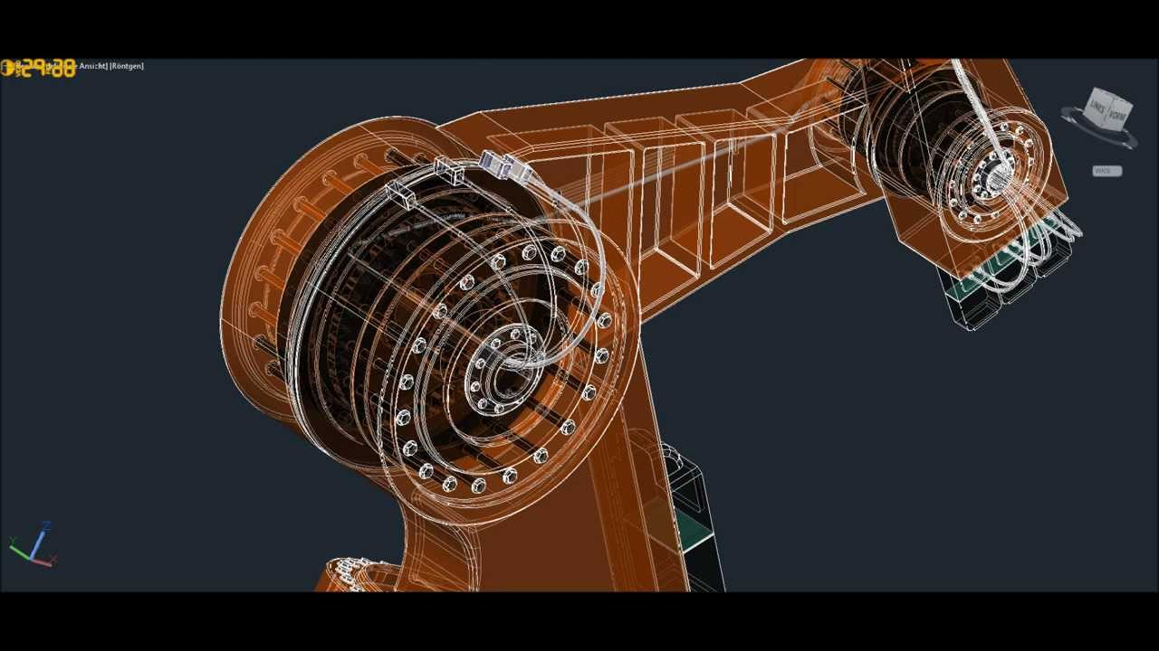
Different types of visualization
https://www.youtube.com/watch?v=mpechGIfPbw
Scientific visualization
Information visualization

Slide 9
Challenges in information visualization
Which graphs can be used for analysis of my data?
How to create these graphs?
How should these graphs be analysed?
How to make these graphs looking good enough for publication or presentation?

Slide 10
Why is visualization important?
Human sight = primary resource for information understanding
Visualization is often the quickest way for data understanding
The way of data visualization may affect decision making dramatically

Slide 11
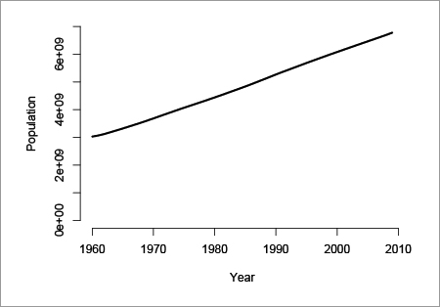
Why is visualization important?
Decision here: population does not increase so much, no intervention needed
Decision here: population increases quickly, intervention is required
Visual perception problem

Slide 12
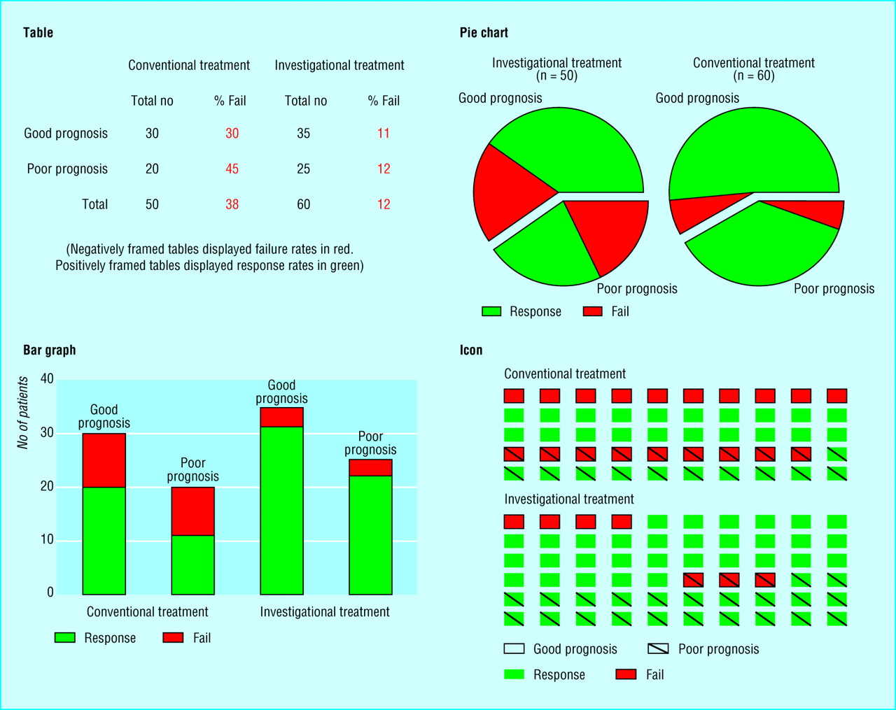
Why is visualization important?
Source: Elting Linda S, Martin Charles G, Cantor Scott B, Rubenstein Edward B. Influence of data display formats on physician investigators' decisions to stop clinical trials: prospective trial with repeated measures BMJ 1999; 318 :1527

Slide 13
Visualization aims
Visualization for exploration
Clusters
Trends
Anomalies
…
Confirmatory visualization
Example 1: Perform linear regression, analyse residuals→ was linear regression reasonable
Example 2: Discover clusters by K-means, visualize clusters→ are they clusters actually?
Visualization for presentation

Slide 14
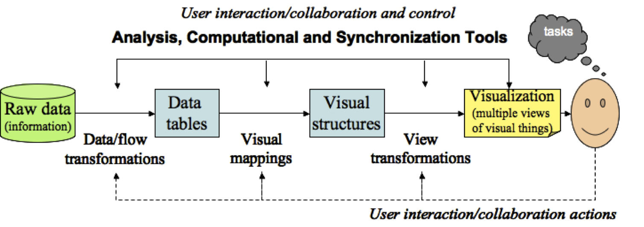
Visualization pipeline
Key ingredient: mapping data columns to visual structures (aesthetics)

Slide 15
The role of perception
Human visual system has limitations
These limitations may lead to wrong/incomplete analysis of graphs
Understanding how we see→ better displays
Misleading graphics needs to be avoided

Slide 16
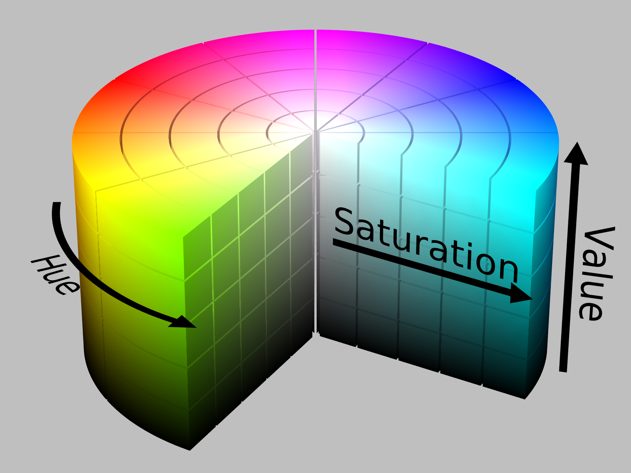
Colors
Color= hue + saturation + value (lightness)
8% of males are color deficient→ what are good colors?
https://henrydangprg.com/2016/06/26/color-detection-in-python-with-opencv/

Slide 17
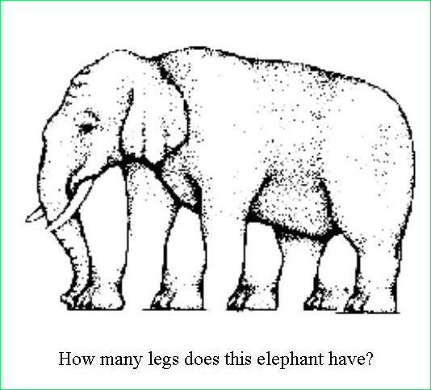

Illusions
http://www.ilusa.com/gallery/elephant-illusion.jpg

Slide 18
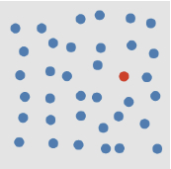
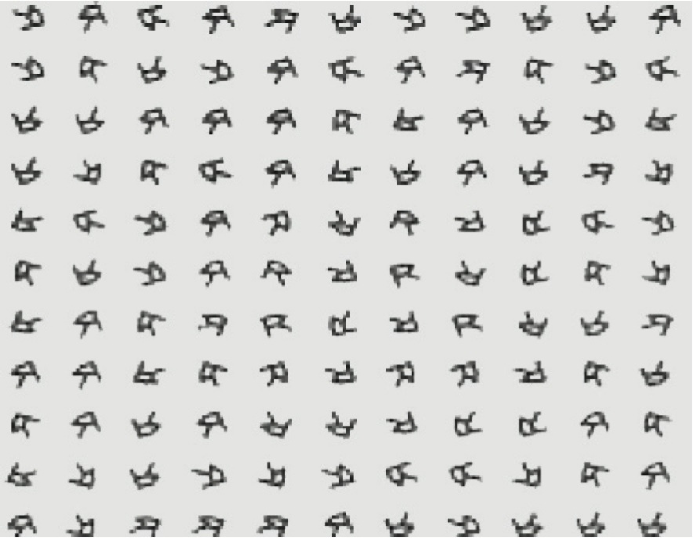
Preattentive processing
Certain aesthetics are fast to process
How quickly can you identify a red dot?
How quickly can you identify a square of right-handed Rs?

Slide 19
The role of perception
How can this affect analysis?

Slide 20
Data preprocessing
Viewing raw data is often prefered
Sometimes some preprocessing is needed
Missing values and Data cleaning
Discard the bad record →may remove almost all data
Assign sentinel value
Column mean imputation
Nearest neighbor imputation
Other imputations

Slide 21
Data preprocessing
Normalization
Converting column to range [0,1]. Useful in for ex. color mapping
Centering and scaling 0/1
Nonlinear transformations: log, sqrt
Segmentation
Split data according to some column

Slide 22
Data preprocessing
Sampling, subsetting and expanding
Random sampling reduces size of data and facilitates overplotting (for ex. scatterplots)
Interpolation: linear (one dimension), bilinear (two dimensions), nonlinear. Select necessary amount of intrepolation points.
Dimension reduction
PCA
MDS
Other techniques (ex. ICA, Autoencoders), welcome to Machine Learning course…

Slide 23
Data preprocessing
Mapping nominal dimensions to numbers
Random mapping should never be done unless intrinsic ordering is present
Use other numeric variables to measure in the data to measure “closeness” of values in the nominal variable
Correspondence analysis
Aggregation and summarization
Grouping observations
Computing summary statistics per group

Slide 24
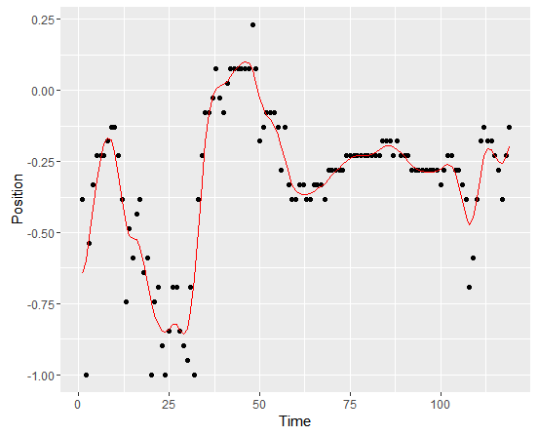
Data preprocessing
Smoothing and filtering
Replace original values with a smoothed versions

Slide 25
Software
Commercial:
SAS and SAS JMP – environment. Special visual tools are available (JMP), require separate license. Well documented. Good even for large sets. SAS Enterprise Guide has many visual static tools
Spotfire – Many static and interactive visualization tools
Tableau– Many static and interactive visualization tools
InfoScope – visualizing maps, interactive visualizations
Free:
R – programming language. Set of packages is constantly updated. A lot of statistical tools (even the newest methods) Badly documented
Plotly – a tool for interactive and dynamic graphics, R interface available
Shiny - – a tool for R-based web applications using graphics
GraphViz – visualization of graph data, coding needed
Jigsaw – Text analysis

Slide 26
Software
Tools for the web (used by web designers):
ActionScript
JavaScript
Prefuse
VTK
… much more references given in the course book

Slide 27
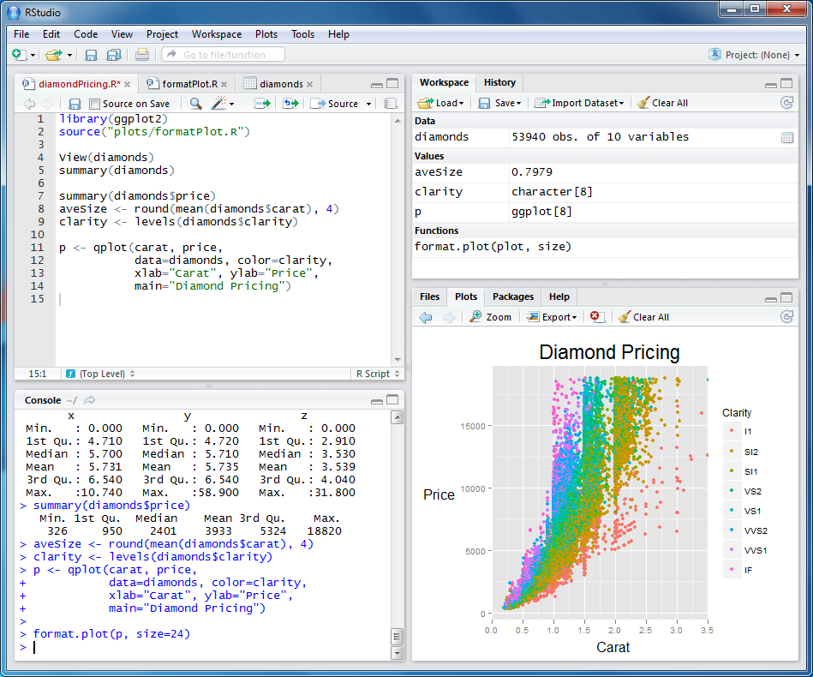
Course software
Install R: http://www.r-project.org/
Install RStudio: http://rstudio.org/
Program
Workspace
Plots
Execution console

Slide 28
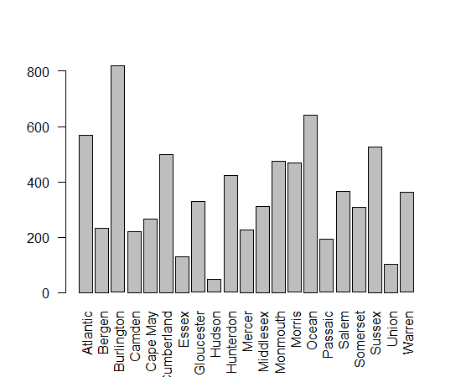
Graphical tools in R
R base: basic plotting, not publication quality
Grob package: low-level plotting tools, new types of plots
Zhou, Lutong, and W. John Braun. "Fun with the r grid package." Journal of Statistics Education 18.3 (2010).

Slide 29
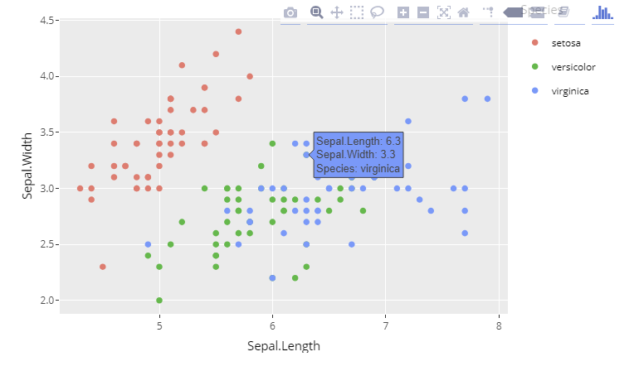
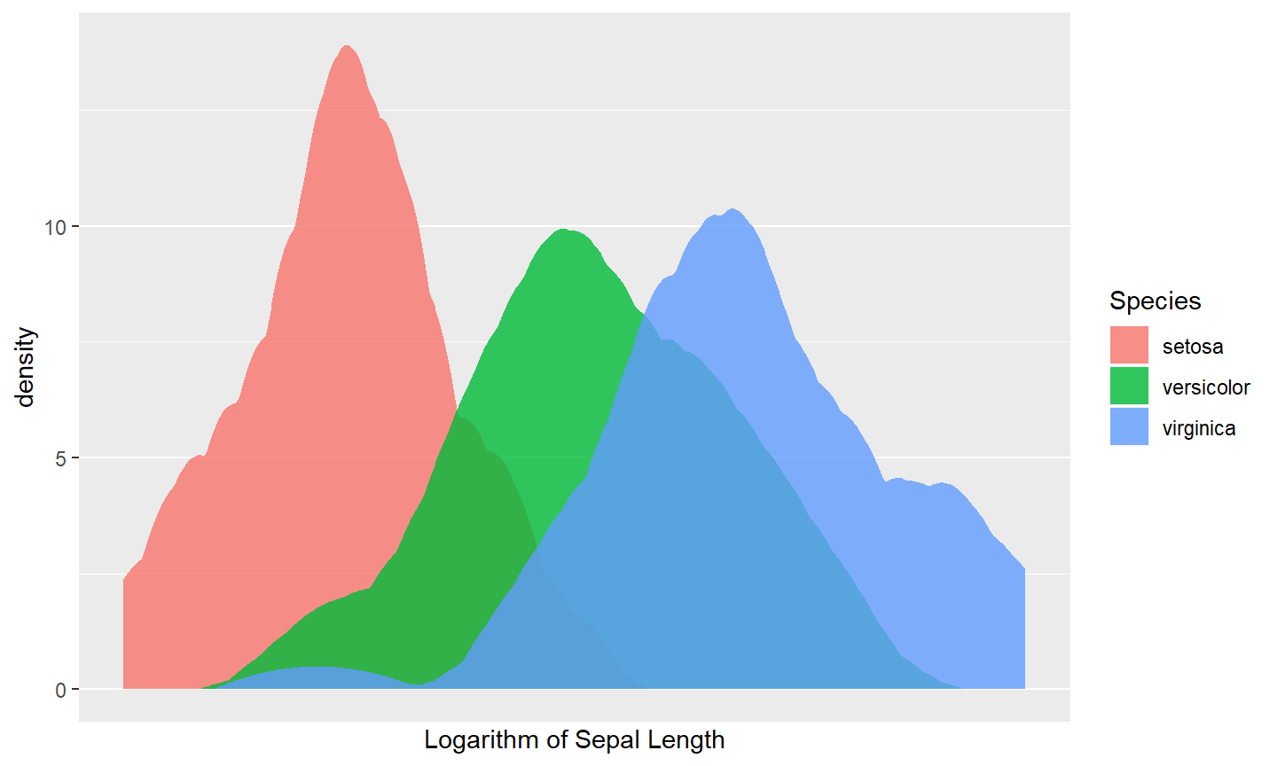
Graphical tools in R
Ggplot2 package: based on grammar of graphics, close to publication quality
Plotly package: Ggplot2 + interactivity

Slide 30
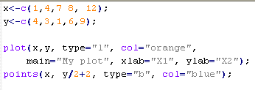
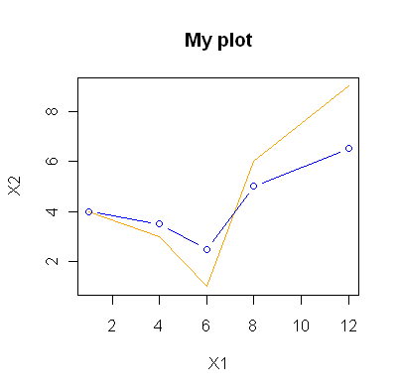
Graphical procedures
Base R graphical procedures:
plot(x,..) plots time series
plot(x,y) scatter plot
plot(x,y) followed by points(x,y) plots several scatterplots in one coordinate system
hist(x,..) plots a hitogram
persp(x,y,z,…) creates surface plots
cloud(formula,data..) creates 3D scatter plot

Slide 31
Publication quality graphics
Visualization for exploration
Default settings
Visualization for presentation for publication
Higher quality graphics is required
Improve the graph quality in the software (often requires quite a bit of programming)
Use postprocessing tools, such as Inkscape or Adobe Illustrator

Slide 32
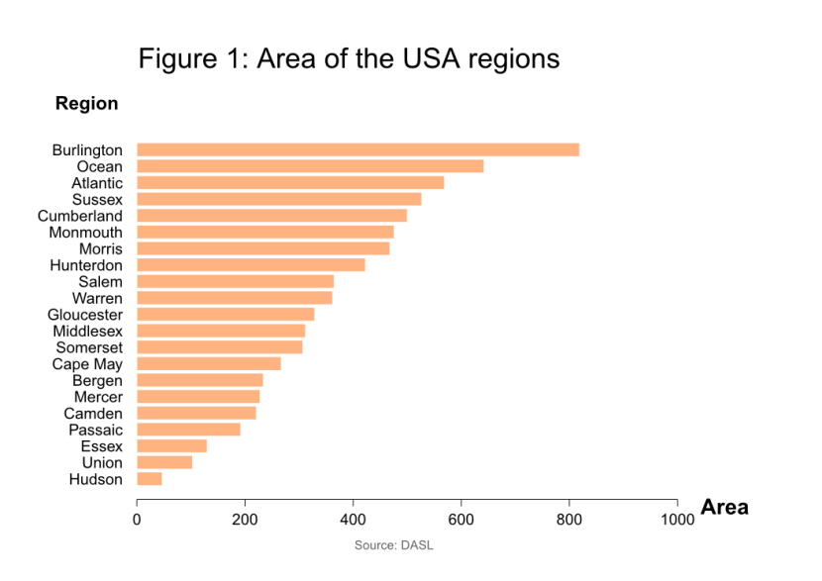
Publication quality graphics
Plot processed in Inkscape
Example: Compare two plots and state what is improved in the second plot.

Slide 33

Making publication quality graphics
Install Inkscape
http://inkscape.org/
Inkscape is an open source, SVG-based vector drawing program
file format that Inkscape uses is compact and quickly transmittable over the Internet.
Vector graphics: image is defined in terms of lines, not pixels
Benefit: can be enlarged without loss of picture quality
Save your R plot as PDF and import it to Inkscape
Make changes and export your plot as a PNG-file or save it as PDF.
Bitmap image and vector image (enlarged)

Slide 34
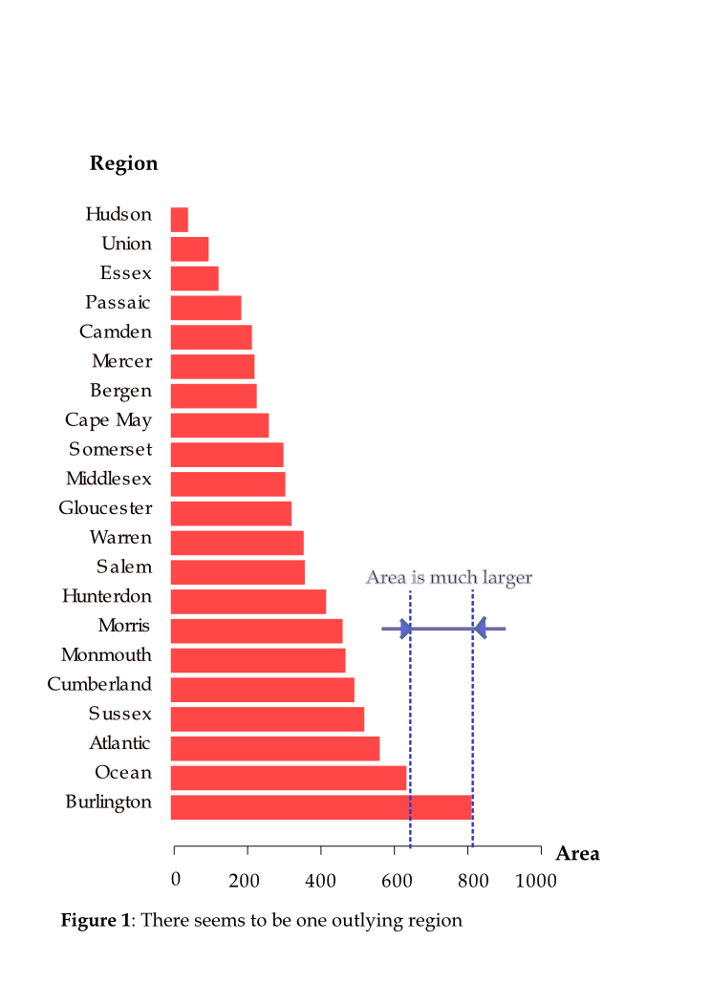
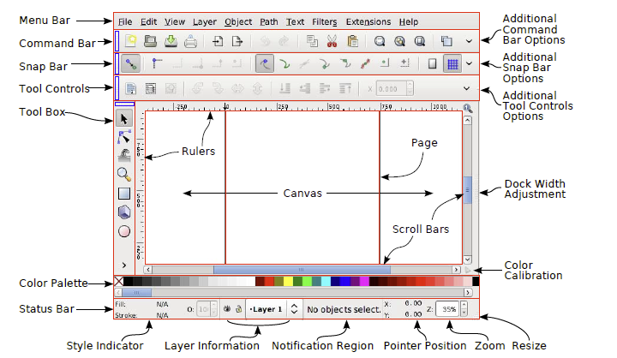
Inkscape
Menu bar (Important: File, Object, Path, Text, View→Grid)
Command bar (Zoom to fit page, Edit object’s colors)
Tool controls
Tool box (Select and transform, zoom, Text, Eraser, Fill)
Color palette
Status bar

Slide 35
Home reading
Course book, chapters 1.1, 1.3-1.8 and 2
Manual to InkScape: http://tavmjong.free.fr/INKSCAPE/MANUAL/html/index.php

